Slide 1
Signals and Systems
Feedback, Poles, and Fundamental Modes
April 2024
Presented by Nyatega, C.O

Slide 2


Feedback, Poles, and Fundamental Modes
Verbal descriptions: preserve the rationale.
“To reduce the number of bits needed to store a sequence of large numbers that are nearly equal, record the ﬁrst number, and then record successive diﬀerences.”
Diﬀerence equations: mathematically compact.
y[n] = x[n] − x[n − 1]
Block diagrams: illustrate signal ﬂow paths.
x[n] +
y[n]
−1
Delay
Operator representations: analyze systems as polynomials.
Y = (1 − R) X

Slide 3


Last Time: Feedback, Cyclic Signal Paths, and Modes
Systems with signals that depend on previous values of the same signal are said to have feedback.
Example: The accumulator system has feedback.
+
X Y
Delay
By contrast, the diﬀerence machine does not have feedback.
+
X Y
−1
Delay

Slide 4

Last Time: Feedback, Cyclic Signal Paths, and Modes
The eﬀect of feedback can be visualized by tracing each cycle through the cyclic signal paths.
+
X Y
p₀
Delay
x[n] = δ[n]
y[n]
n
n
−1 0 1 2 3 4
−1 0 1 2 3 4
Each cycle creates another sample in the output.

Slide 5
Last Time: Feedback, Cyclic Signal Paths, and Modes
The eﬀect of feedback can be visualized by tracing each cycle through the cyclic signal paths.
+
X Y
p₀
Delay
x[n] = δ[n]
y[n]
n
n
−1 0 1 2 3 4
−1 0 1 2 3 4
Each cycle creates another sample in the output.

Slide 6
Last Time: Feedback, Cyclic Signal Paths, and Modes
The eﬀect of feedback can be visualized by tracing each cycle through the cyclic signal paths.
+
X Y
p₀
Delay
x[n] = δ[n]
y[n]
n
n
−1 0 1 2 3 4
−1 0 1 2 3 4
Each cycle creates another sample in the output.

Slide 7
Last Time: Feedback, Cyclic Signal Paths, and Modes
The eﬀect of feedback can be visualized by tracing each cycle through the cyclic signal paths.
+
X Y
p₀
Delay
x[n] = δ[n]
y[n]
n
−1 0 1 2 3 4
n
−1 0 1 2 3 4
Each cycle creates another sample in the output.
The response will persist even though the input is transient.

Slide 8
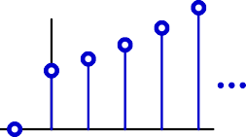
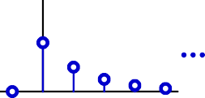
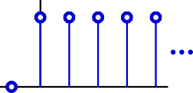
Geometric Growth: Poles
These unit-sample responses can be characterized by a single number
— the pole — which is the base of the geometric sequence.
+
X Y
p₀
Delay
p₀ , if n >= 0; 0, otherwise.
n
y[n] =
y[n]
y[n]
y[n]
n
n
n
−1 0 1 2 3 4
p₀ = 0.5
−1 0 1 2 3 4
p₀ = 1
−1 0 1 2 3 4
p₀ = 1.2

Slide 9
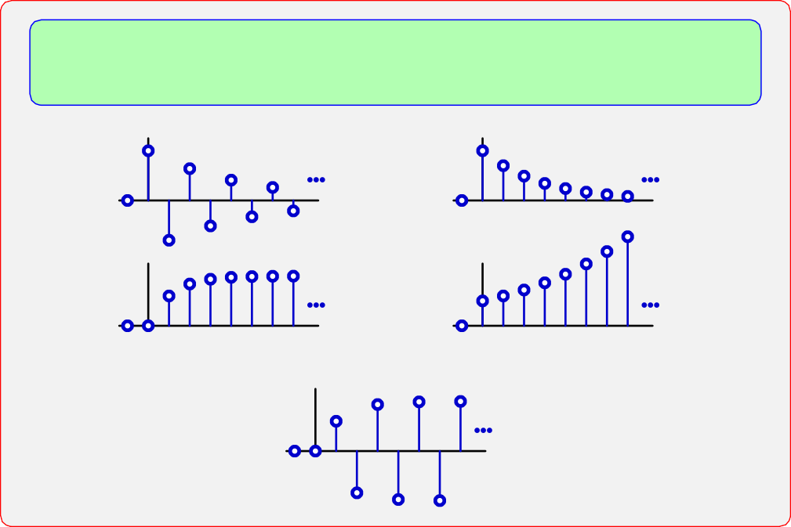
Check Yourself
How many of the following unit-sample responses can be represented by a single pole?
n
n
n
n
n

Slide 10
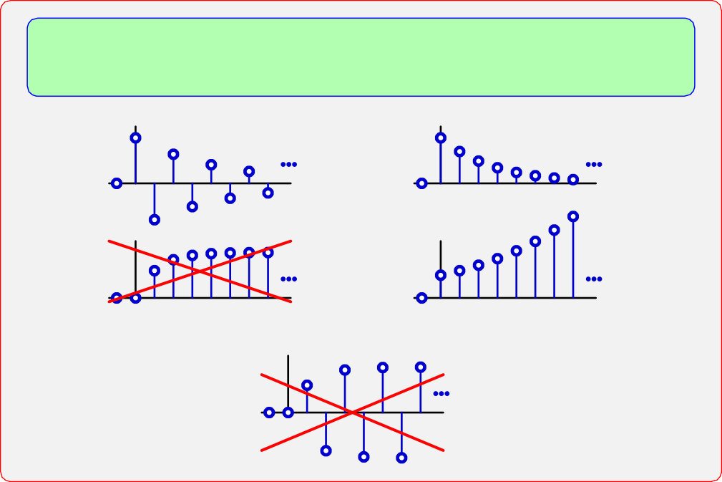
Check Yourself
How many of the following unit-sample responses can be represented by a single pole? 3
n
n
n
n
n

Slide 11
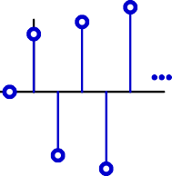
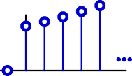
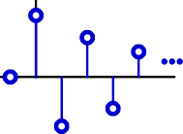

Geometric Growth
The value of p₀ determines the rate of growth.
y[n]
y[n]
y[n]
y[n]
z
−1
0
1
p₀ < −1:
magnitude diverges, alternating sign magnitude converges, alternating sign magnitude converges monotonically magnitude diverges monotonically
−1 < p₀ < 0:
0 < p₀ < 1:
p₀ > 1:

Slide 12



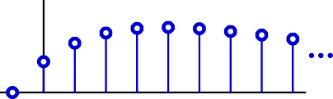
Second-Order Systems
The unit-sample responses of more complicated cyclic systems are more complicated.
+
X Y
R
1.6
R
−0.63
y[n]
n
−1 0 1 2 3 4 5 6 7 8
Not geometric. This response grows then decays.

Slide 13

Factoring Second-Order Systems
Factor the operator expression to break the system into two simpler systems (divide and conquer).
+
X Y
R
1.6
R
−0.63
Y = X + 1.6RY − 0.63R
2_{Y}
2
(1 − 1.6R + 0.63R ) Y = X
(1 − 0.7R)(1 − 0.9R) Y = X

Slide 14
Factoring Second-Order Systems
The factored form corresponds to a cascade of simpler systems.
(1 − 0.7R)(1 − 0.9R) Y = X
Y₂
X
+
+
Y
0.7 R
(1 − 0.7R) Y₂ = X
0.9 R
(1 − 0.9R) Y = Y₂
Y₁
X
+
+
Y
0.9 R
(1 − 0.9R) Y₁ = X
0.7 R
(1 − 0.7R) Y = Y₁
The order doesn’t matter (if systems are initially at rest).

Slide 15
Factoring Second-Order Systems
The unit-sample response of the cascaded system can be found by multiplying the polynomial representations of the subsystems.
Y ₌ 1 ₌ 1 × 1
X (1 − 0.7R)(1 − 0.9R) (1 − 0.7R) (1 − 0.9R)
_ _
_
_
= (1 + 0.
7R + 0.
2 2
3 3
2 2
7 R + 0.
7 R + · · ·
) × (1 + 0.9R + 0.9 R + 0.9³ ³ + · · · )
R
Multiply, then collect terms of equal order:
Y X
2
= 1 + (0.7 + 0.9)R + (0.7² + 0.7 × 0.9 + 0.9²)R
+ (0.7³ + 0.7² × 0.9 + 0.7 × 0.9² + 0.9³)R
³ + · · ·

Slide 16
Multiplying Polynomial
Graphical representation of polynomial multiplication.
Y
2 _{+ a}3 2 _{+ b}3
= (1 + aR + a²R
3 2
R + · · ·) × (1 + bR + b R
3
R + · · ·)
X
1
1
a
R
_{R}2
b
R
_{R}2
X
_{a}2
+
_{b}2
+
Y
_{a}3
_{R}3
_{b}3
_{R}3
... ...
...
...
Collect terms of equal order:
Y
= 1 + (a + b)R + (a² + ab + b²)
2 3 2 2 3 3
R + (a + a b + ab + b )R + · · ·
X

Slide 17
Multiplying Polynomials
Tabular representation of polynomial multiplication.
2 3 3 2 2 3 3
(1 + aR + a²R + a R + · · ·) × (1 + bR + b R + b R + · · ·)
_{b}2_{R}2 _{b}3_{R}3
1 bR · · ·
_{b}2_{R}2
_{b}3_{R}3
1
1 bR
_{ab3R4} · · ·
· · ·
· · ·
· · ·
· · ·
aR
aR abR²
ab²R³
_{a}2_{R}2
_{a}2_{R}2
a²bR³
_{a}2_{b}2_{R}4
_{a}2_{b}3_{R}5
_{a}3_{R}3
_{a}3_{R}3
a³bR⁴
_{a}3_{b}2_{R}5
_{a}3_{b}3_{R}6
· · · · · · · · · · · · · · ·
Group same powers of R by following reverse diagonals:
Y X
2 3 2 2 3 3
= 1 + (a + b)R + (a² + ab + b²)R + (a + a b + ab + b )R + · · ·
y[n]
n
−1 0 1 2 3 4 5 6 7 8

Slide 18


Partial Fractions
Use partial fractions to rewrite as a sum of simpler parts.
+
X Y
R
1.6
R
−0.63
Y 1
₂ ₌ 1 ₌ 4.5 ₋ 3.5
=
X 1 − 1.6R + 0.63R (1 − 0.9R)(1 − 0.7R) 1 − 0.9R 1 − 0.7R

Slide 19
Second-Order Systems: Equivalent Forms
The sum of simpler parts suggests a parallel implementation.
Y ₌ 4.5 ₋ 3.5
X 1 − 0.9R 1 − 0.7R
Y₁
X
+
4.5
+
Y
0.9
R
Y₂
+
−3.5
0.7
R
If x[n] = δ[n] then y₁[n] = 0.9^{n} and y₂[n] = 0.7^{n} for n ≥ 0.
Thus, y[n] = 4.5(0.9)^{n} − 3.5(0.7)^{n} for n ≥ 0.

Slide 20


Partial Fractions
Graphical representation of the sum of geometric sequences.
y₁[n] = 0.9^{n} for n ≥ 0
n
−1 0 1 2 3 4 5 6 7 8
y₂[n] = 0.7^{n} for n ≥ 0
n
−1 0 1 2 3 4 5 6 7 8
y[n] = 4.5(0.9)^{n} − 3.5(0.7)^{n}
for n ≥ 0
n
−1 0 1 2 3 4 5 6 7 8

Slide 21
Partial Fractions
Partial fractions provides a remarkable equivalence.
+
X Y
R
1.6
R
−0.63
Y₁
X
+
4.5
+
Y
0.9
R
Y₂
+
−3.5
0.7
R
→ follows from thinking about system as polynomial (factoring).

Slide 22
Poles
The key to simplifying a higher-order system is identifying its poles.
Poles are the roots of the denominator of the system functional
1
when R → .
z
Start with system functional:
Y 1 1 1
= ₂ = =
X 1 − 1.6R+0.63R (1−p₀R)(1−p₁R) (1−0.7R) (1−0.9R)
^{-.} p₀..=,.0.7 ^{.. -.} p₁..=,.0.9 ..
1
z
Substitute R →
and ﬁnd roots of denominator:
Y X
1
1.6 ₊ 0.63
z
2 2
z
=
=
= ₍
2
6z +0
.63 z−0.7) (z−0.9)
1 −
z −1.
z
_{z}2
^{-.}z₀..=,.0.7^{.. -.}z₁..=,.0.9..
The poles are at 0.7 and 0.9.

Slide 23
Check Yourself
Consider the system described by
1 1 1
y[n] = − ₄ y[n − 1] + ₈ y[n − 2] + x[n − 1] − ₂ x[n − 2]
How many of the following are true?
The unit sample response converges to zero.
There are poles at z = ¹ and z = ¹ .
There is a pole at z = ¹ .
There are two poles.
None of the above
2 4
2

Slide 24
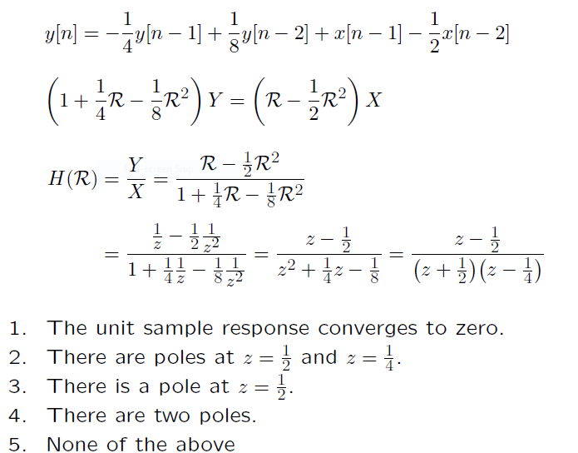

Slide 25
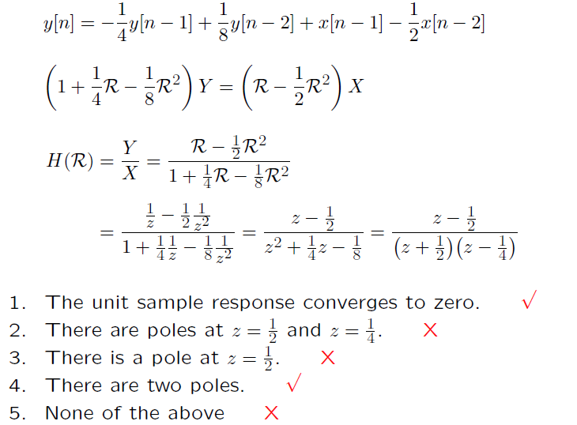

Slide 26
Check Yourself
Consider the system described by
1 1 1
y[n] = − ₄ y[n − 1] + ₈ y[n − 2] + x[n − 1] − ₂ x[n − 2]
How many of the following are true? 2
The unit sample response converges to zero.
There are poles at z = ¹ and z = ¹ .
There is a pole at z = ¹ .
There are two poles.
None of the above
2 4
2

Slide 27

Population Growth

Slide 28


Population Growth

Slide 29
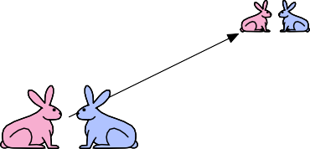
Population Growth

Slide 30

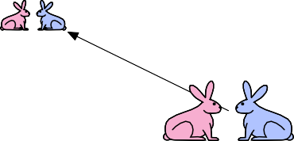
Population Growth

Slide 31
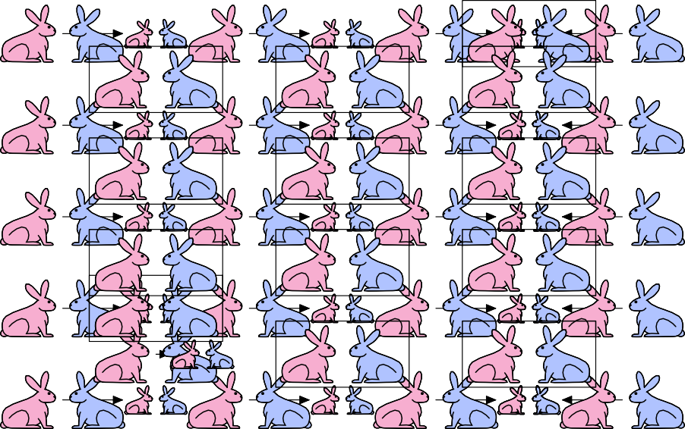
Population Growth

Slide 32
Check Yourself
What are the pole(s) of the Fibonacci system?
1. 1
1 and −1
−1 and −2
1.618 . . . and −0.618 . . .
none of the above

Slide 33
Check Yourself
What are the pole(s) of the Fibonacci system?
Diﬀerence equation for Fibonacci system:
y[n] = x[n] + y[n − 1] + y[n − 2]
System functional:
Y 1
H = =
X 1 − R − R²
Denominator is second order → 2 poles.

Slide 34
Check Yourself
Find the poles by substituting R → 1/z in system functional.
Y 1
1
1 1
_{z}2
H = =
→
=
z² − z − 1
X 1 − R − R
2
1 − −
z _{z}2
Poles are a√t
_{z =} 1 ±₂ 5 ₌
φ or − ¹
φ
where φ represents the “golden ratio”
1 + √5
2
φ =
≈ 1.618
The two poles are at
z₀ = φ ≈ 1.618 and
1
z₁ = −_{φ} ≈ −
0.618

Slide 35
Check Yourself
What are the pole(s) of the Fibonacci system? 4
1. 1
1 and −1
−1 and −2
1.618 . . . and −0.618 . . .
none of the above

Slide 36
Example: Fibonacci’s Bunnies
Each pole corresponds to a fundamental mode.
1
φ ≈ 1.618 and − _{φ} ≈ −0.618
3 4
n
1
_{φ}n
−_{φ}
n
−1 0 1 2 3 4
n
−1 0 1 2 3 4
One mode diverges, one mode oscillates!

Slide 37
Example: Fibonacci’s Bunnies
The unit-sample response of the Fibonacci system can be written as a weighted sum of fundamental modes.
φ 1
Y 1
√₅
H = =
=
+
φ√5 1
2
X 1 − R − R 1 − φR
1 + R
φ
φ 1
n −n
h[n] = √₅ φ + _{φ}√₅ (−φ) ; n ≥ 0
But we already know that h[n] is the Fibonacci sequence f :
f : 1, 1, 2, 3, 5, 8, 13, 21, 34, 55, 89, . . .
Therefore we can calculate f [n] without knowing f [n − 1] or f [n − 2] !

Slide 38
Complex Poles
What if a pole has a non-zero imaginary part?
Example:
Y 1
=
2
X 1 − R₁ + R
z
2
=
=
1 1
2
1 − +
z − z + 1
z
z
2
√
1 3
±jπ/3
Poles are z = ± j = e
.
2 2
What are the implications of complex poles?

Slide 39
Complex Poles
Partial fractions work even when the poles are complex.
�
_{e} jπ/3 _{e}−jπ/3
_{1 − e} jπ/3_{R} ⁻ _{1 − e}−jπ/3_{R}
�
Y ₌ 1 × 1 ₌ 1
X 1 − e ^{jπ/3}R 1 − e^{−jπ/3}R j√3
There are two fundamental modes (both geometric sequences):
e ^{jnπ/3} = cos(nπ/3) + j sin(nπ/3) and e^{−jnπ/3} = cos(nπ/3) − j sin(nπ/3)
n
n

Slide 40
Complex Poles
Complex modes are easier to visualize in the complex plane.
e ^{jnπ/3} = cos(nπ/3) + j sin(nπ/3)
Im
_{e} j2π/3 _{e} j1π/3
_{e} j3π/3
_{e} j0π/3
Re
n
_{e} j4π/3
_{e} j5π/3
e^{−jnπ/3} = cos(nπ/3) − j sin(nπ/3)
_{e} j4π/3
Im
_{e} j5π/3
_{e} j3π/3
_{e} j0π/3
Re
n
_{e} j2π/3
_{e} j1π/3

Slide 41
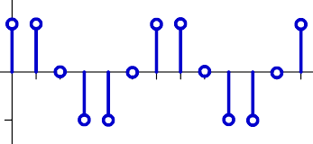
Complex Poles
The output of a “real” system has real values.
y[n] = x[n] + y[n − 1] − y[n − 2]
Y 1
H = =
X 1 − R + R²
₌ 1 × 1
_{1 − e} jπ/3_{R 1 − e}−jπ/3_{R}
(
_{e} jπ/3 _{e}−jπ/3
_{1 − e} jπ/3_{R} ⁻ _{1 − e}−jπ/3_{R}
₌ 1
j√3
1
3 −j(n+1)π/3
2 (n + 1)π 3
h[n] = √ e
j 3
j(n+1)π/
− e
= √₃ sin
h[n] 1
n
−1

Slide 42
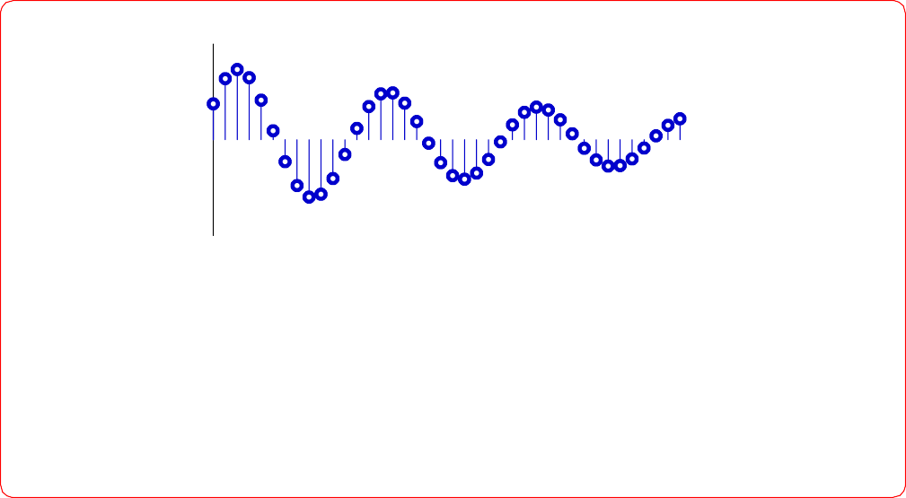
Check Yourself
Unit-sample response of a system with poles at z = re^{±jΩ}.
n
Which of the following is/are true?
r < 0.5 and Ω ≈ 0.5
0.5 < r < 1 and Ω ≈ 0.5
r < 0.5 and Ω ≈ 0.08
0.5 < r < 1 and Ω ≈ 0.08
none of the above

Slide 43
Check Yourself
Unit-sample response of a system with poles at z = re^{±jΩ}.
n
Which of the following is/are true? 2
r < 0.5 and Ω ≈ 0.5
0.5 < r < 1 and Ω ≈ 0.5
r < 0.5 and Ω ≈ 0.08
0.5 < r < 1 and Ω ≈ 0.08
none of the above

Slide 44
Check Yourself
X
+
R
R
R
Y
How many of the following statements are true?
This system has 3 fundamental modes.
All of the fundamental modes can be written as geometrics.
Unit-sample response is y[n] : 0, 0, 0, 1, 0, 0, 1, 0, 0, 1, 0, 0, 1 . . .
Unit-sample response is y[n] : 1, 0, 0, 1, 0, 0, 1, 0, 0, 1, 0, 0, 1 . . .
One of the fundamental modes of this system is the unit step.

Slide 45
Check Yourself
X
+
R
R
R
Y
How many of the following statements are true? 4
This system has 3 fundamental modes.
All of the fundamental modes can be written as geometrics.
Unit-sample response is y[n] : 0, 0, 0, 1, 0, 0, 1, 0, 0, 1, 0, 0, 1 . . .
Unit-sample response is y[n] : 1, 0, 0, 1, 0, 0, 1, 0, 0, 1, 0, 0, 1 . . .
One of the fundamental modes of this system is the unit step.

Slide 46
Summary
Systems composed of adders, gains, and delays can be characterized by their poles.
The poles of a system determine its fundamental modes.
The unit-sample response of a system can be expressed as a weighted sum of fundamental modes.
These properties follow from a polynomial interpretation of the sys­ tem functional.

